Slide 1
Object Oriented Programming Introduction
CS(217) Object Oriented Programming
Abeeda Akram

Slide 2
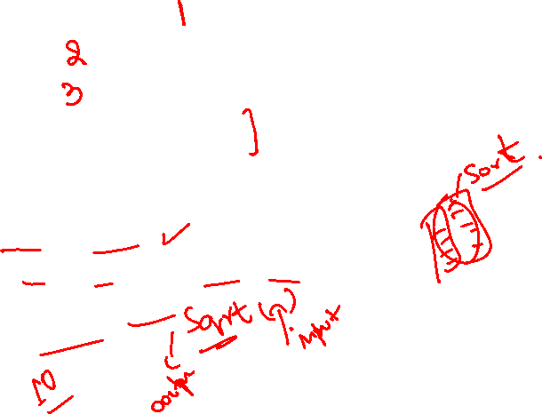
Procedural or Structured Programming
Centered around procedures (functions)
Take data as parameters
Process data
Return results
Provide procedural abstraction
Hide low level implementation details from user
Examples:
Search (Linear or Binary)
Sorting (Bubble, Selection , Even-Odd, Insertion)
Square Root Calculation
Prime Numbers

Slide 3



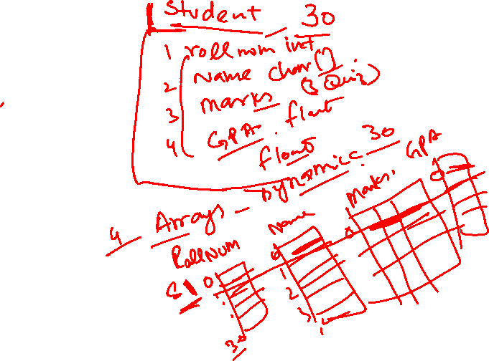
What’s Wrong with Procedural Programming?
Complex programs
Programs are difficult to modify and extend
Examples Management Systems
Student
Health Care
Inventory
Library

Slide 4
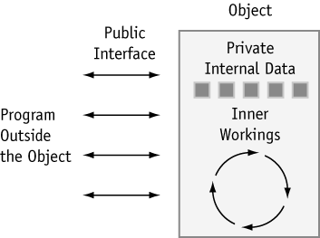
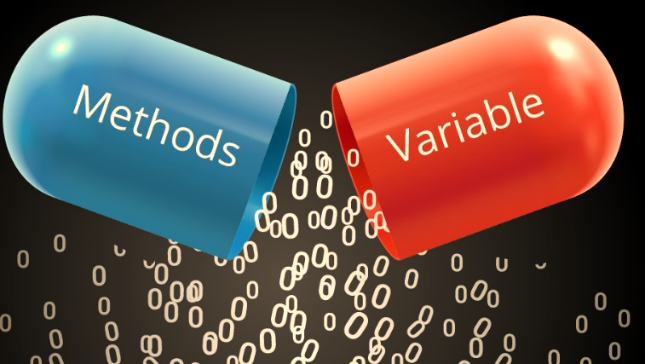
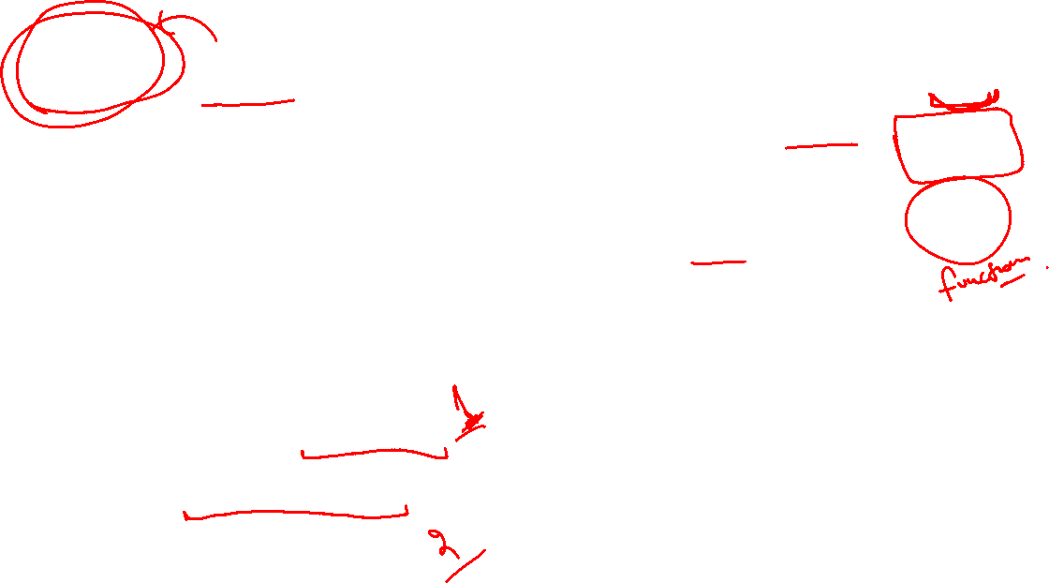
Object Oriented Programming
Centered around Objects
An Object has combined
Data storage
Functions
Provides Encapsulation
Information and implementation hiding
Provides Abstraction
Data abstraction
Hide low level storage details
Procedural abstraction
Hide implementation of an action and low level functional details

Slide 5
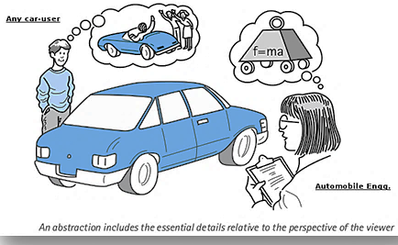
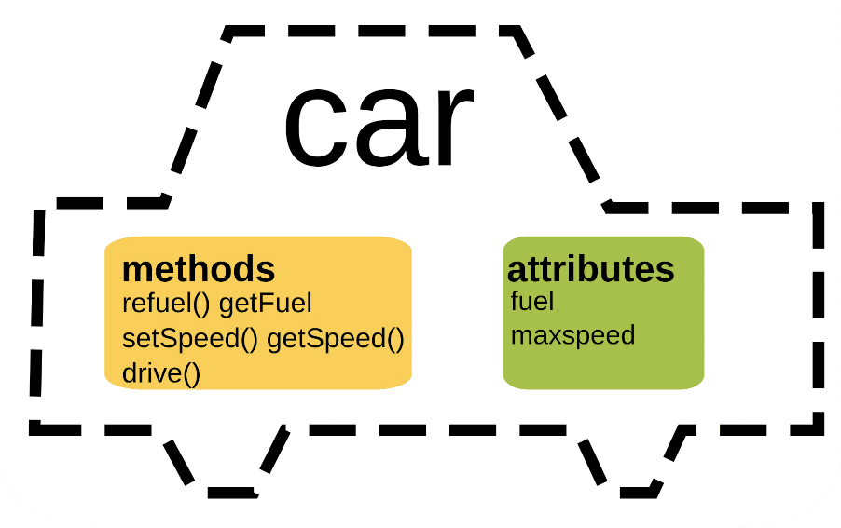
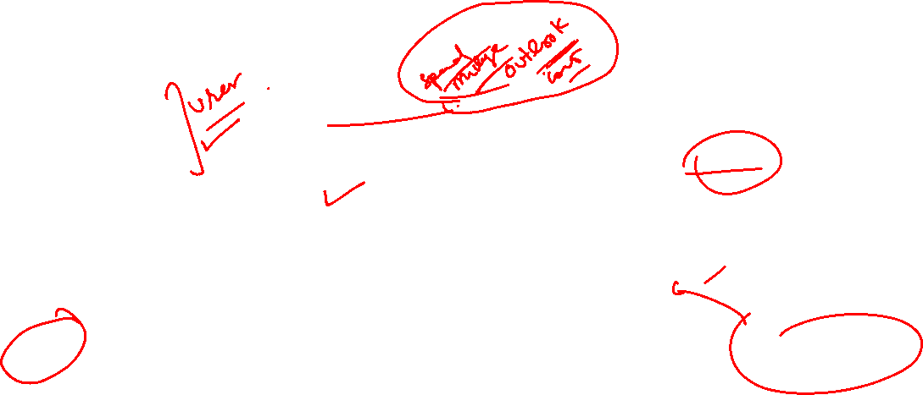
Object Oriented Programming
User is concerned with only working
What it takes?
What it does?
What it returns?
Hide How it actually do that?

Slide 6
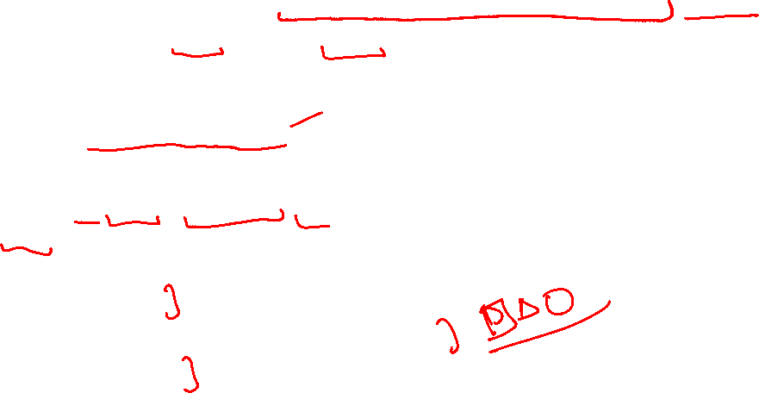
Object Oriented Programming Use
Commonly used to create user defined abstract data types (ADTs)
Which are very specific Or very general in purpose
Improve built in C++ data types
Arrays (with boundary checks),
String (with additional Functionalities)
Create missing datatypes from C++ as if they were built-in data types.
Matrices (Simple, Triangular, Sparce)
Sets
Creating objects that perform commonly needed tasks
Input validation
Screen output in a graphical user interface
Voice processing

Slide 7

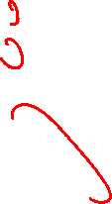
Object Oriented Programming Use
Data types created for a specific application.
For example,
Student Management System
Student
Course
Hospital Management System
Doctor
Patient
Appointments

